Slide 1



AtliQ Technologies
Business
Insights 360

Slide 2

Hello,
I’m Nikhil
An aspiring Data Analyst
Today, I’ll be presenting a Power BI project that I have crafted during my journey with the codebasics boot camp 3.0

Slide 3

Content
Company Overview
Business Model
Problem
Objective
Dashboard Brief
Dashboard Walkthrough

Slide 4

Company Snapshot
AtliQ Technology is a leading global consumer electronics brand, specializing in a wide range of hardware products like PCs, mouse, keyboards etc

Slide 5


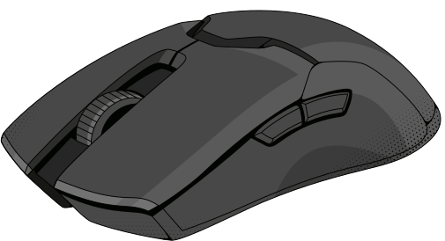
Product Line
Peripherals: Mouse, keyboards, batteries.
Accessories: USB drives, SSDs.
Storage & Networking: Wi-Fi extenders, HDDs.
Laptops & Desktops: Business and gaming laptops, personal desktops.

Slide 6




Business Modal
RETAILER
Consumer
DIRECT
E stores & Exclusive
DISTRIBUTOR
NEPTUNE

Slide 7
Problem Statement
AtliQ grew substantially but had a bitter experience in Latin America due to the decision of opening their store
They made all these decisions just based on some surveys and based on their intuition
This decision leads to significant financial loss

Slide 8
OBJECTIVE
For the future of the company, senior executives are investing in data analytics projects & onboarding skilled data professionals
Previously, they relied on Excel files but now they seek a more robust solution given company’s growth
To bring transparency into their data so that they can make accurate data-driven decisions.

Slide 9











Dashboard Overview
LINK
FINANCE VIEW
MARKETING VIEW
EXECUTIVE VIEW
HOME
SALES VIEW
SUPPLY CHAIN VIEW
INFORMATION
&
SUPPORT VIEW

Slide 10



THANK YOU
For watching this presentation
NIKHIL GOSWAMI
+91-6377465850
nikhilgoswaminkg@gmail.com
www.reallygreatsite.com

